Slide 1
Dynamic Modelling with UML

Slide 2
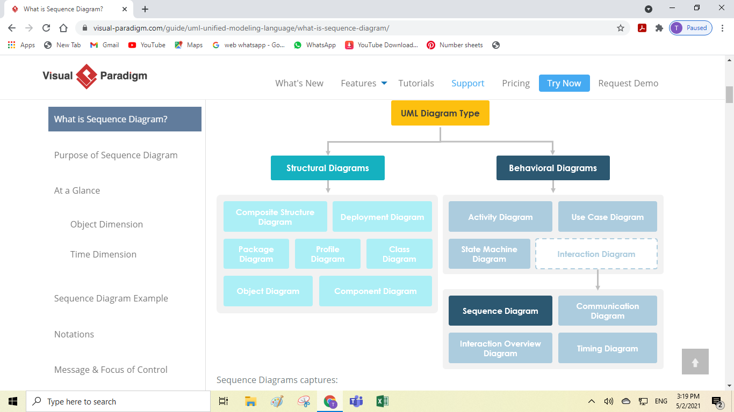

Slide 3
Dynamic Modeling
Definition of dynamic model:
• Describes the components of the system that have
interesting dynamic behaviour.
The dynamic model is described with
• State diagrams: One state diagram for each class with
important dynamic behaviour.
• Sequence diagrams: For the interaction between
Classes.(Stateless Dynamic Modelling)
• Purpose is to Detect and supply methods for the object model

Slide 4
Diagrams for Dynamic Modelling
• Interaction diagrams describe the dynamic behavior between objects
• Statechart diagrams describe the dynamic behavior of a single object

Slide 5
Dynamic Diagrams

Slide 6
Interaction Diagrams for View alarm Use Case

Slide 7
Interaction Diagram
Two types of interaction diagram:
• Sequence Diagram:
• Describes the dynamic behaviour of several objects
over time.
• Good for real-time specifications.
A Sequence diagram is an interaction diagram that details about the operation that is carried out. Sequence diagram captures the interaction between the objects in the context of collaboration. Sequence diagrams are time focused and they show the order of the interaction visually by using the vertical axis of the diagram to represent time.
• Collaboration/ Communication Diagram:
• Shows the temporal relationship among objects.
• Position of objects is based on the position of the
classes in the UML class diagram.
• Does not show time.
Collaboration Diagram represents the interaction of the objects to perform the behavior of a particular use case or a part of use case. The designers use the Sequence diagram and Collaboration Diagrams to define and clarify the roles of the objects that perform a particular flow of events of a use case.

Slide 8
How do we detect Methods?
Purpose:
• Detect and supply methods for the object model
• How do we do this?
• We look for objects, who are interacting and extract
their “protocol”.
• We look for objects, who have interesting behavior on
their own
• We start with the flow of events in a use case
• From the flow of events we proceed to the sequence
diagram

Slide 9
What is an Event?
Something that happens at a point in time
• An event sends information from one object to another
• Events can have associations with each other:
• Causally related:
• An event happens always before another event
• An event happens always after another event
• Causally unrelated:
• Events can happen concurrently
• Events can also be grouped in event classes with
a hierarchical structure => Event taxonomy

Slide 10
The term ‘Event’ is often used in two ways
Instance of an event class:
• “Slide 10 shown on Tuesday Dec 5 at 10:30”.
• Event class “Lecture Given”, Subclass “Slide Shown”
Attribute of an event class
• Slide Update(5:30 AM, 12/4/2006)
• Train_Leaves(4:45pm, Manhattan)
• Mouse button down(button#, tablet-location)

Slide 11
MESSAGE SEQUENCE NUMBERING ON INTERACTION DIAGRAMS
Message Labels on Interaction Diagrams
[sequence expression]: Message Name (argument list)
Message sequence number
The first message sequence number represents the event that initiates the message sequence depicted on the communication diagram. Typical message
sequences are 1, 2, 3, . . . ; A1, A2, A3, . . .
Message name. The message name is specified.
Argument list. The argument list of the message is optional and specifies any parameters sent as part of the message
Recurrence. The recurrence term is optional and represents conditional or iterative execution. The recurrence term represents zero or more messages that are sent, depending on the conditions being met.
1. ∗ [iteration-clause]. An asterisk (∗) is added after the message sequence number to indicate that more than one message is sent.
2. [condition-clause]. A condition is specified in square brackets to indicate a branch condition. The optional condition clause is used for specifying branches – for example, [x < n] – meaning that the message is sent only if the condition is true.

Slide 12
Use Case Diagram

Slide 13
Message Sequence

Slide 14
Sequence Diagram
A sequence diagram is a graphical description of the objects participating in a use case using a DAG notation
Heuristic for finding participating objects:
• A event always has a sender and a receiver.
• Find them for each event
=> These are the objects participating in the use case
• Relation to object identification:
=> Several objects/classes have already been identified
during object modeling.
• New objects are now identified as a result of dynamic
Modeling.

Slide 15
Communication/Collaboration Diagrams

Slide 16
Sequence Diagram

Slide 17
Alternate Sequence

Slide 18
Sequence diagram for the Make Order Request use case: alternative sequence for Create New Account

Slide 19
Diffrences between Sequence Diagram & Collaboration Diagram
The sequence diagram represents the UML, which is used to visualize the sequence of calls in a system that is used to perform a specific functionality.
The sequence diagram are used to represent the sequence of messages that are flowing from one object to another.
The sequence diagram is used when time sequence is main focus.
The sequence diagrams are better suited of analysis activities.
The collaboration diagram also comes under the UML representation which is used to visualize the organization of the objects and their interaction.
The collaboration diagram are used to represent the structural organization of the system and the messages that are sent and received.
The collaboration diagram is used when object organization is main focus.
The collaboration diagrams are better suited for depicting simpler interactions of the smaller number of objects.

Slide 20
Similarities Between Sequence and Collaboration Diagram
In Unified Modelling Language both the sequence diagram and collaboration diagram are used as interaction diagrams.
Both the diagrams details about the behavioral aspects of the system.

Slide 21
An Example
Flow of events in “Get SeatPosition” use case :
1. Establish connection between smart card and
onboard computer.
2. Establish connection between onboard computer and sensor for seat.
3. Get current seat position and store on smart card.
• Where are the objects?

Slide 22
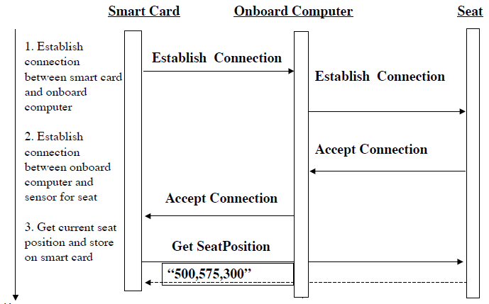
Sequence Diagram for “Get SeatPosition”
Time

Slide 23
Heuristics for Sequence Diagrams
Layout:
1st column: Should correspond to the actor who
initiated the use case
2nd column: Should be a boundary object
3rd column: Should be the control object that
manages the rest of the use case

Slide 24
Heuristics for Sequence Diagrams
• Creation of objects
• Control objects are created at the initiation of a
use case.
• Boundary objects are created by control objects.
• Access of objects
• Entity objects are accessed by control and
boundary objects.
• Entity objects should never access boundary or
control objects.

Slide 25
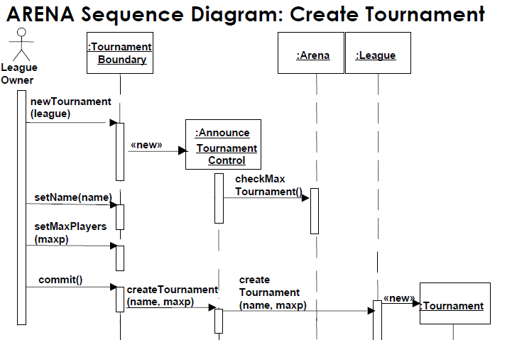
Sequence Diagram

Slide 26
Impact on ARENA’s Object Model
Let’s assume ARENA’s object model contained
the objects
• League Owner, Arena, League, Tournament, Match and Player
•The Sequence Diagram identified new Classes
Tournament Boundary, Announce_Tournament_Control

Slide 27
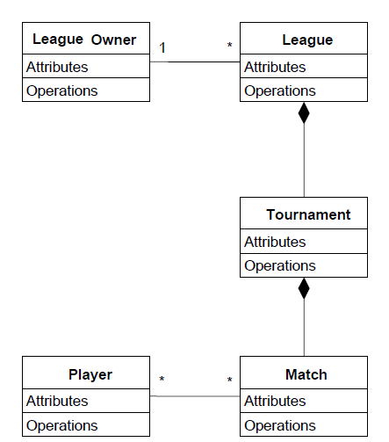
Class Diagram

Slide 28
What else can we get out of Sequence Diagrams?
Sequence diagrams are derived from use cases
• The structure of the sequence diagram helps us to determine how decentralized the system is
• We distinguish two structures for sequence
diagrams
Fork Diagrams and Stair Diagrams (Ivar Jacobsen)

Slide 29
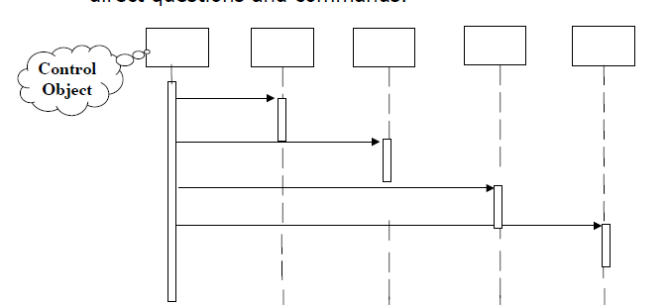
Fork Diagram
The dynamic behavior is placed in a single object, usually a control object.
• It knows all the other objects and often uses them for direct questions and commands.

Slide 30
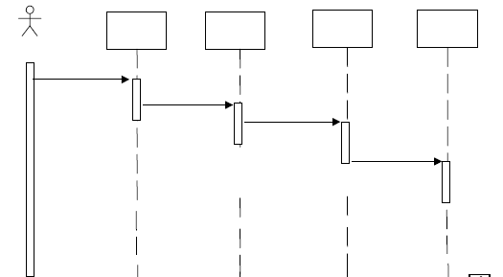
Stair Diagram
• The dynamic behavior is distributed. Each object
delegates responsibility to other objects.
• Each object knows only a few of the other objects and
knows which objects can help with a specific behavior.

Slide 31
Fork or Stair?
• Object-oriented supporters claim that the stair structure is better
• Better heuristics:
• Choose the stair - a decentralized control structure - if
• The operations have a strong connection
• The operations will always be performed in the same order
• Choose the fork –
a centralized control structure - if
• The operations can change order
• New operations are expected to be added as a result of new requirements

